Slide 1


Lam Chi Kin
<Date>

Slide 2

Outline
Executive Summary
Introduction
Methodology
Results
Conclusion
Appendix

Slide 3
Executive Summary
Summary of methodologies
Summary of all results

Slide 4
Introduction
Space X
Advertise Falcon 9 rocket
Launch with cost of $62m
Compare with other providers: up to $165m
Mush of saving because of the reusage of first stage
Determine
Successful rate of Falcon 9 first stage will land successfully
Find the cost of a launch

Slide 5

Section 1

Slide 6
Methodology
Executive Summary
Data collection methodology:
Download Falcon 9 and Falcon Heavy Launch data through
Space X API
Wikipedia
Perform data wrangling
Using BeautifulSoup extract data from HTML
Using Pandas
Data preprocessing
Apply one-hot encoding method to categorical features
Perform exploratory data analysis (EDA) using visualization and SQL
Perform interactive visual analytics using Folium and Plotly Dash
Perform predictive analysis using classification models
Apply Scikit-Learn
Classification:
K-Nearest Neighbors, Decision Tree, Support Vector Machine
Use GridSearchCV to find the best parameters
Evaluate by train dataset
Ratio of train-test size: 8:2

Slide 7
Data Collection
Request data
From Space X API
requests.get()
-> json file
From Wikipedia
BeautifulSoup
Use of Pandas
Convert json file from Space X API to dataframe
.json_normalize()
Convert HTML file from Wiki to dataframe
Data preprocessing
Extract necessary columns
Check and fill missing values

Slide 8
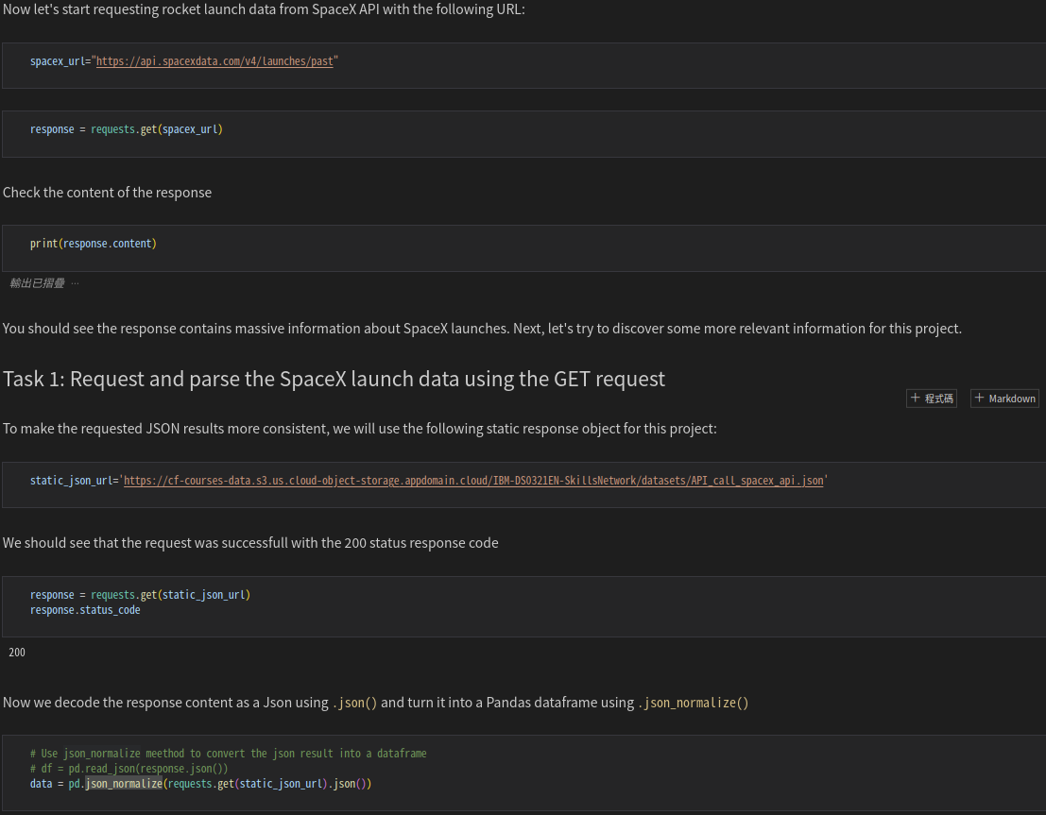
Data Collection – SpaceX API
Space X API
requests.get
Get json data from api
Pandas
.json_normalize()
Convert json to Pandas dataframe
Link:
https://github.com/CKLam33/IBM-Data-Science-Professional-Certificate/blob/main/Applied%20Data%20Science%20Capstone/jupyter-labs-spacex-data-collection-api.ipynb
Place your flowchart of SpaceX API calls here

Slide 9


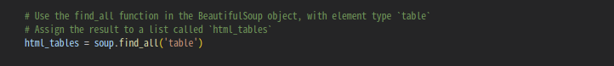
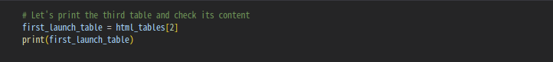
Data Collection - Scraping
Falcon 9 launch data
From Wikipedia
BeautifulSoup
Parse table & convert to Dataframe
With use of Pandas
Link
https://github.com/CKLam33/IBM-Data-Science-Professional-Certificate/blob/main/Applied%20Data%20Science%20Capstone/jupyter-labs-webscraping.ipynb
Place your flowchart of web scraping here

Slide 10
Data Wrangling
Exploratory Data Analysis & Determine Training Labels
Calculate
number of launches on each site
number and occurrence of each orbit
number and occurence of mission outcome per orbit type
Create landing outcome label
From ‘Outcome’
Link:
https://github.com/CKLam33/IBM-Data-Science-Professional-Certificate/blob/main/Applied%20Data%20Science%20Capstone/labs-jupyter-spacex-Data%20wrangling.ipynb

Slide 11

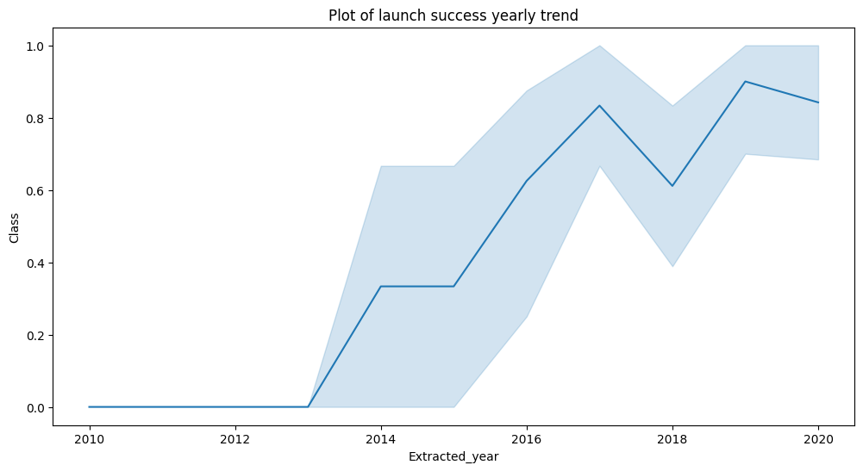
EDA with Data Visualization
Use Matplotlib & Seaborn
Visualize
Launch sites vs Payload
Success rate by class of each Orbits
Launch success yearly trend
Link:
https://github.com/CKLam33/IBM-Data-Science-Professional-Certificate/blob/main/Applied%20Data%20Science%20Capstone/jupyter-labs-eda-dataviz.ipynb

Slide 12
EDA with SQL
Load csv file to database
SQLite
Queries
Name of Launch site
Calculate average payload mass
Find 1st successful landing date
Find number of successful and failure landing outcomes
Link:
https://github.com/CKLam33/IBM-Data-Science-Professional-Certificate/blob/main/Applied%20Data%20Science%20Capstone/jupyter-labs-eda-sql-coursera_sqllite.ipynb

Slide 13
Build an Interactive Map with Folium
Folium with Map function
Circle
Mark launch site
Marker
Recognize success/failed launch for each site
Green: success
Red: fail
Calculate and draw distance
Launch site vs its proximities
Link:
https://github.com/CKLam33/IBM-Data-Science-Professional-Certificate/blob/main/Applied%20Data%20Science%20Capstone/lab_jupyter_launch_site_location.ipynb

Slide 14
Build a Dashboard with Plotly Dash
Pie chart
All launch site: successful rate compare to each site
Each site: display success and fail rate
Scatter chart
Display payload mass of each booster
Range slider
For listener/user to limit the range of payload mass
Find out the success/fail rate of each booster in specific range
Link:
https://github.com/CKLam33/IBM-Data-Science-Professional-Certificate/blob/main/Applied%20Data%20Science%20Capstone/spacex_dash_app.py

Slide 15
Predictive Analysis (Classification)
Select ‘Class’ from train data as result label
Covert to array with numpy
Scikit-Learn
Standardize: preprocessing.StandardScaler()
split train/test data: train_test_split()
Search best parameter among classification methods
Logistic regression, Support Vector Machine, Decision Tree, kNN
With use of GridSearchCV
Compare different classification methods
Find the best method
By compare accuracy score
Link:
https://github.com/CKLam33/IBM-Data-Science-Professional-Certificate/blob/main/Applied%20Data%20Science%20Capstone/SpaceX_Machine%20Learning%20Prediction_Part_5.ipynb

Slide 16
Results
Exploratory data analysis results
Interactive analytics demo in screenshots
Predictive analysis results

Slide 17

Section 2

Slide 18
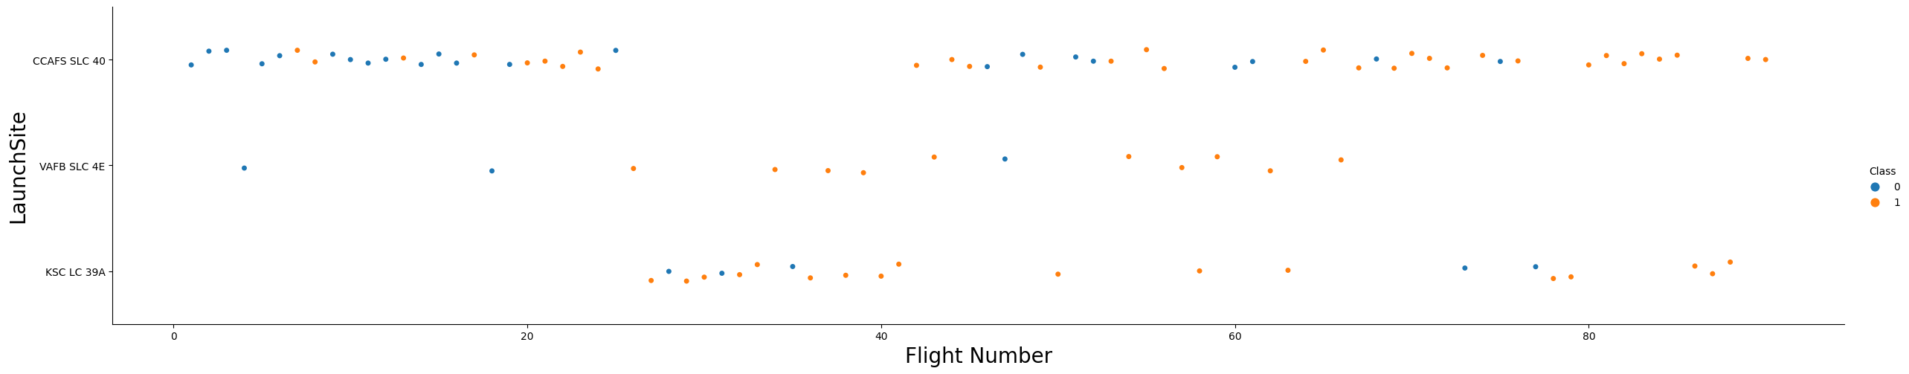
Flight Number vs. Launch Site
Scatter plot of Flight Number vs. Launch Site
Most rockets are launched at CCAFS SLC 40
Number of success outcome increase along the number of flight

Slide 19
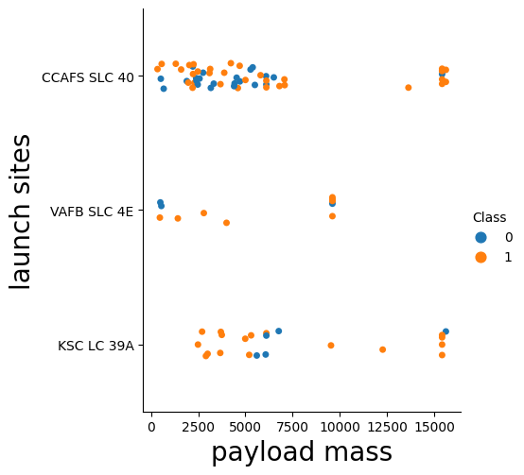
Payload vs. Launch Site
Most Payload Mass of flights < 7500
Few flights with Payload Mass between 7500 and 15000
Only few flights use VAFB SLC 4E

Slide 20
Success Rate vs. Orbit Type
ES-L1, GEO, HEO, SSO
Greatest success rate among orbits
VLEO
> 80% success rate

Slide 21
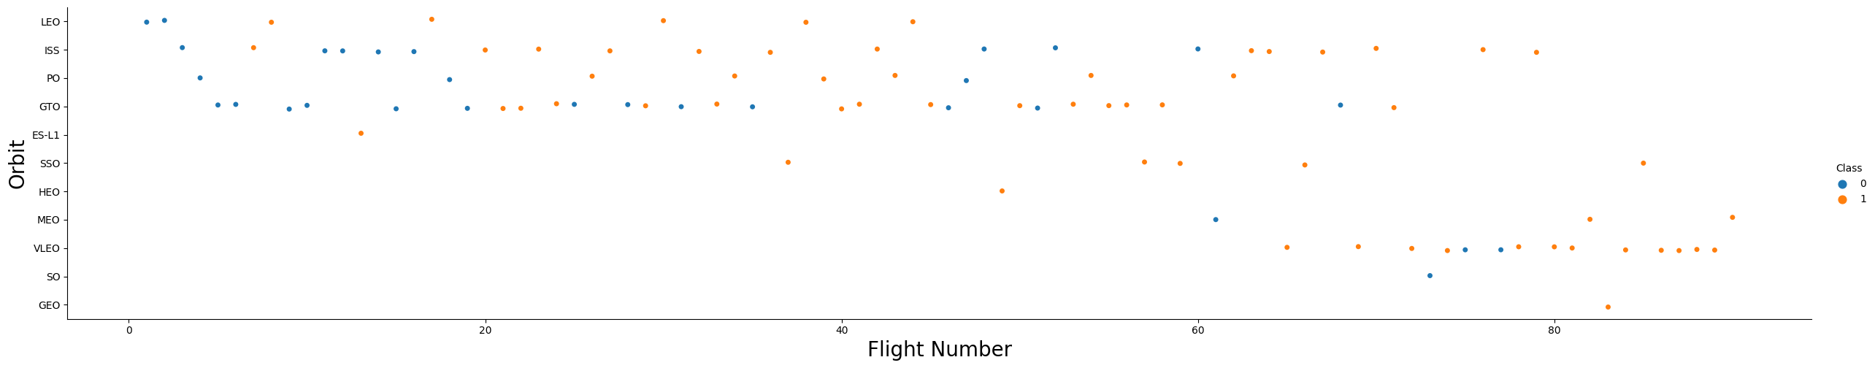
Flight Number vs. Orbit Type
LEO, ISS, PO, GTO
Most used orbits in early time
VLEO
Start to replace old orbit

Slide 22
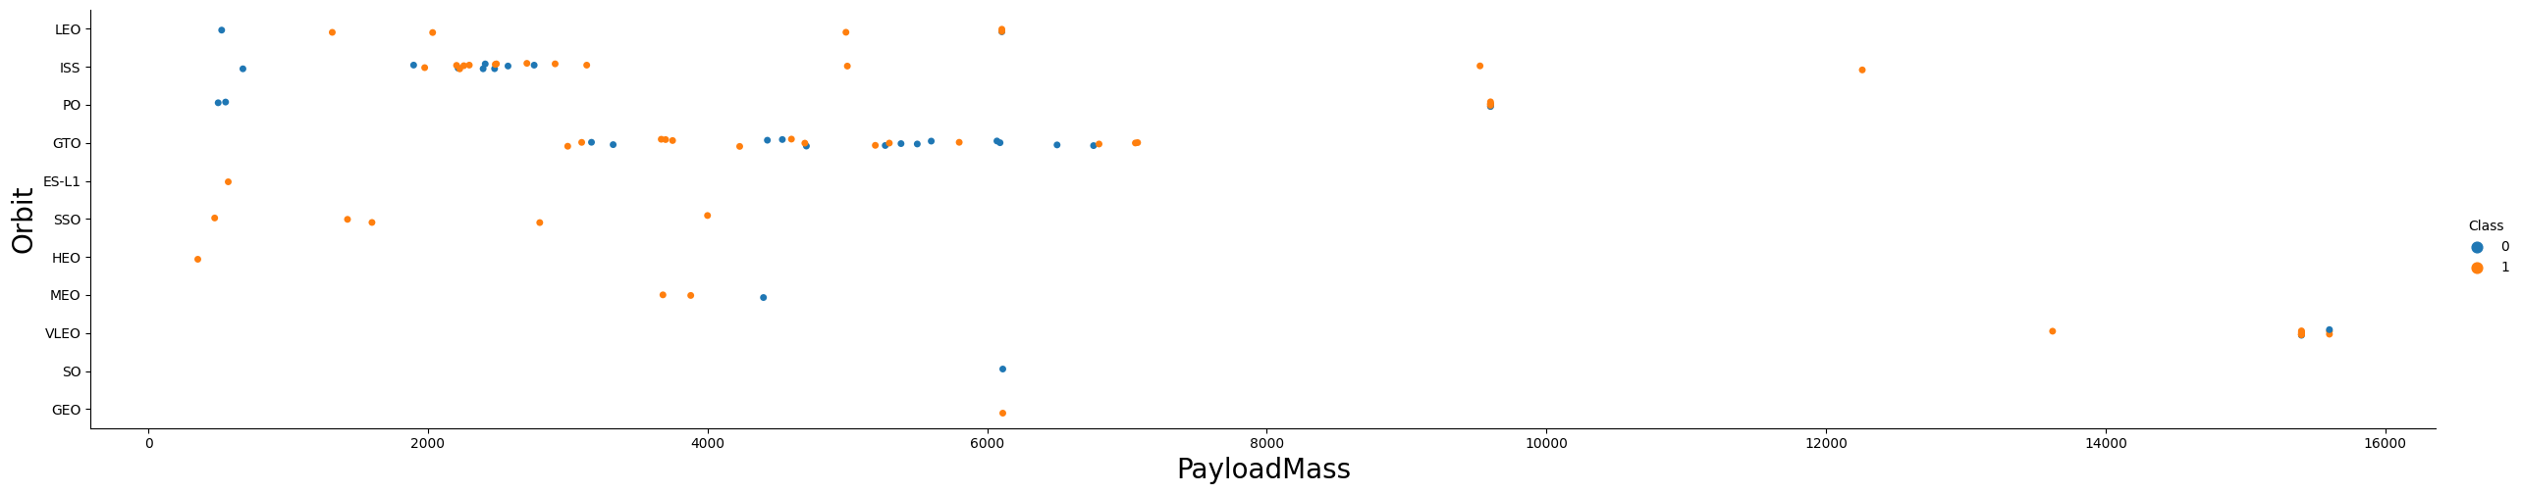
Payload vs. Orbit Type
ISS & GTO
Mostly for payload mass < 8000
GTO -> high fail rate
VLEO
For high payload mass

Slide 23
Launch Success Yearly Trend
Overall success rate increase since 2013
Significant drop in 2018

Slide 24
All Launch Site Names
Find the names of the unique launch sites
Present your query result with a short explanation here

Slide 25
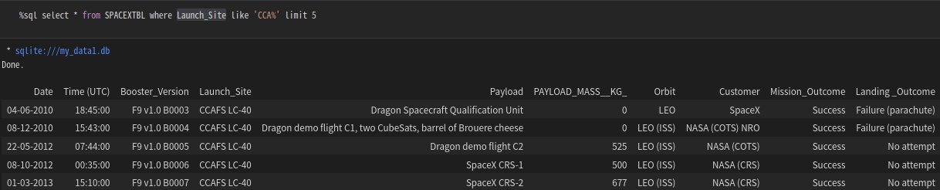
Launch Site Names Begin with 'CCA'
All mission outcomes were success
First 2 records were qualification test
Fail to land to parachute
Did not let booster land to any place after first 2 attempt

Slide 26
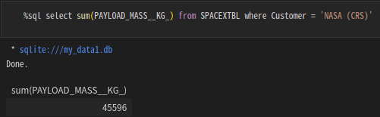
Total Payload Mass
Total payload mass from NASA was 45596kg

Slide 27
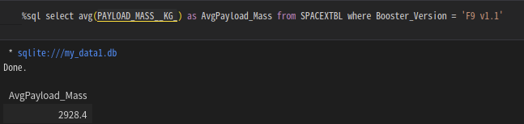
Average Payload Mass by F9 v1.1
Average payload mass by F9 v1.1 was 2928.4kg

Slide 28
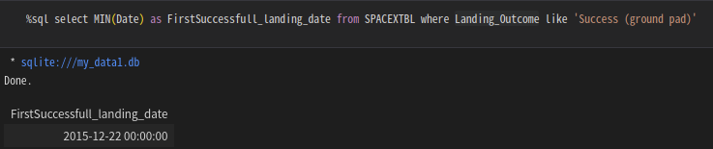
First Successful Ground Landing Date
1st successful landing to ground pad
22nd Dec 2015

Slide 29
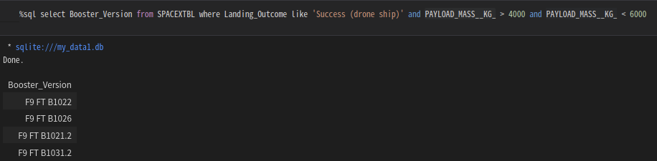
Successful Drone Ship Landing with Payload between 4000 and 6000
Boosters that land to drone ship successfully with Payload between 4000 and 6000:

Slide 30
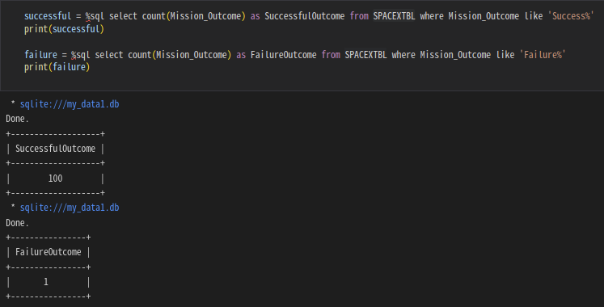
Total Number of Successful and Failure Mission Outcomes
Most missions are success
Only 1 failed

Slide 31
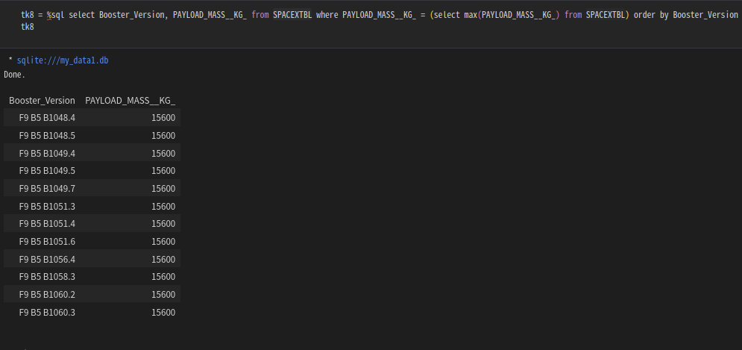
Boosters Carried Maximum Payload
F9 B5 series has the most payload mass with 15600kg

Slide 32
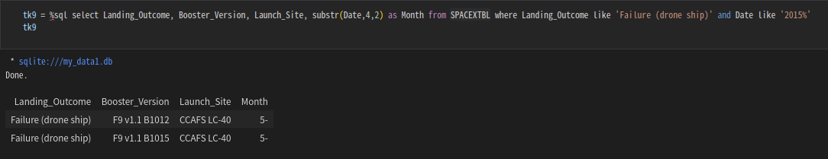
2015 Launch Records
In year 2015, 2 failure in landing drone ship
Both were F9 v1.1 in May

Slide 33
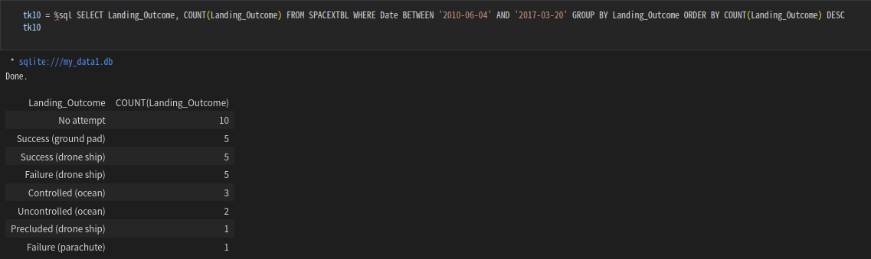
Rank Landing Outcomes Between 2010-06-04 and 2017-03-20

Slide 34

Section 3

Slide 35
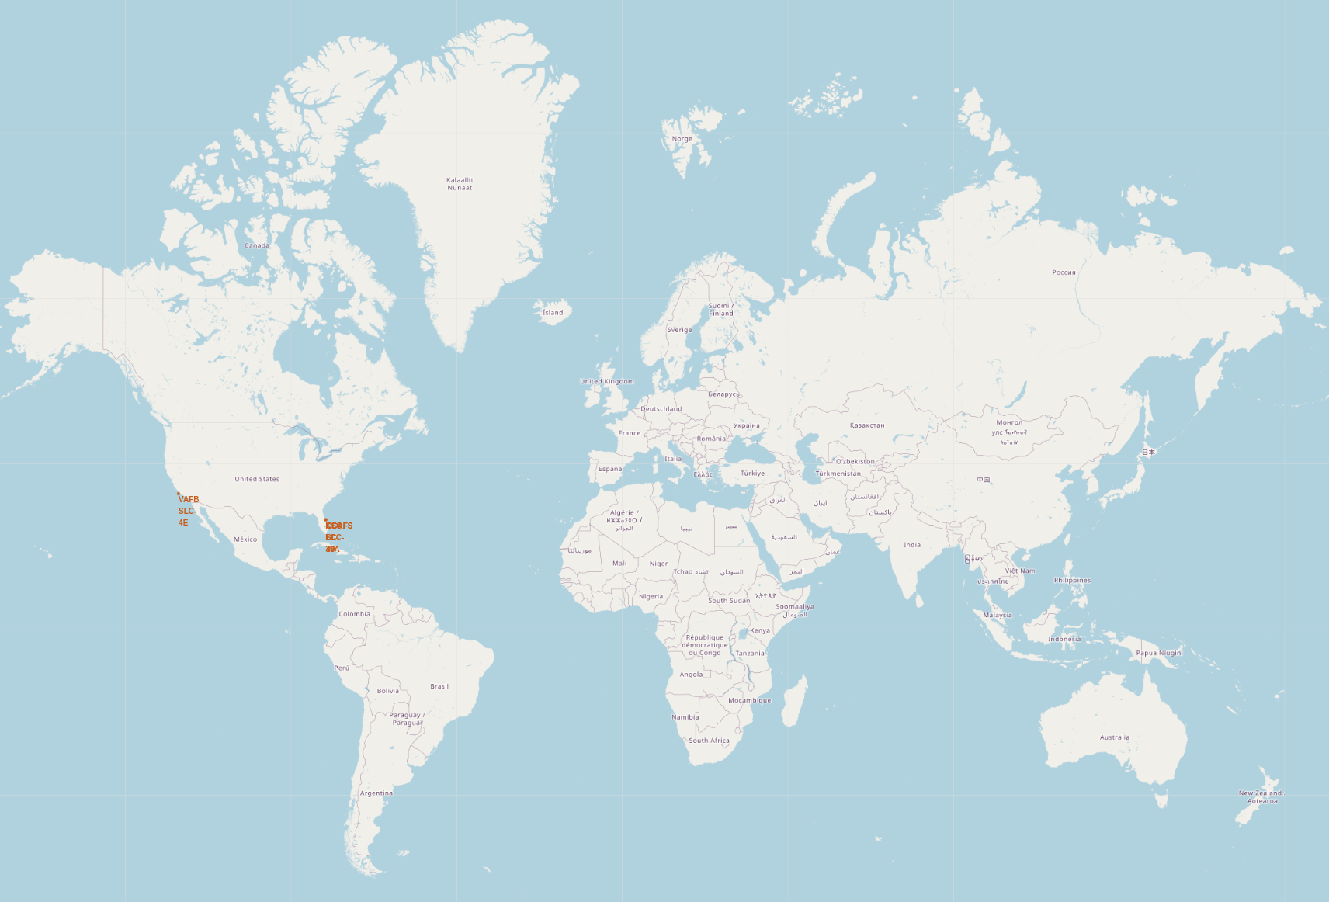
Launch site of Space X in global map
Florida and California in USA are the only places Space X to launch their rocket

Slide 36
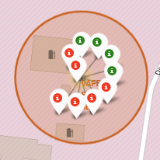
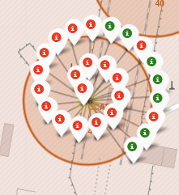
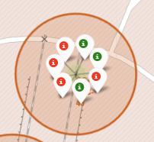
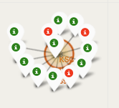
Color-labeled launched outcomes on map
VAFB SLC-4E
KSC LC-39A
CCAFS LC-40
CCAFS SLC-40

Slide 37
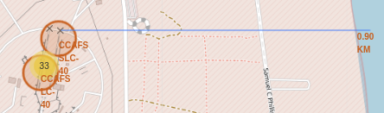
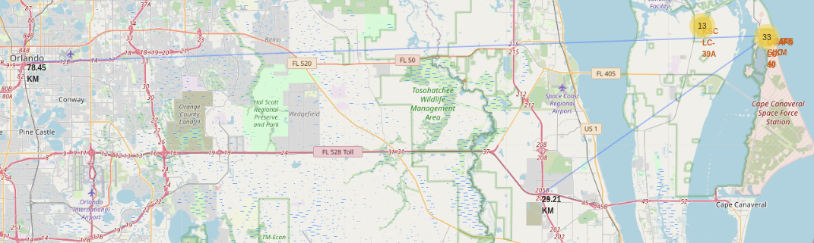
Launch site distance to landmarks in Florida
Closest coast
Centre of Orlando
Closest highway

Slide 38

Section 4

Slide 39
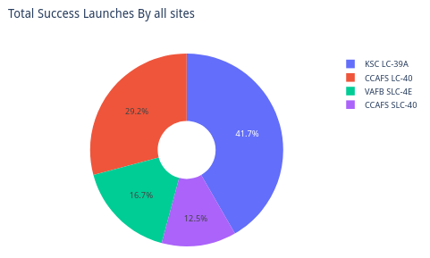
Pie chart of success launches by all sites
KSC LC-39A
Has most success launches in all site
CCAFS SLC-40
The least success launches in all site

Slide 40
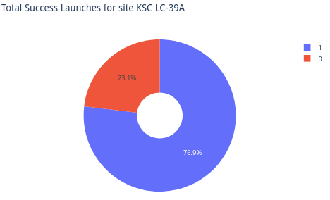
Pie chart of total success launches in KSC LC-39A
76.9% of successful rate
23.1% of failure rate

Slide 41
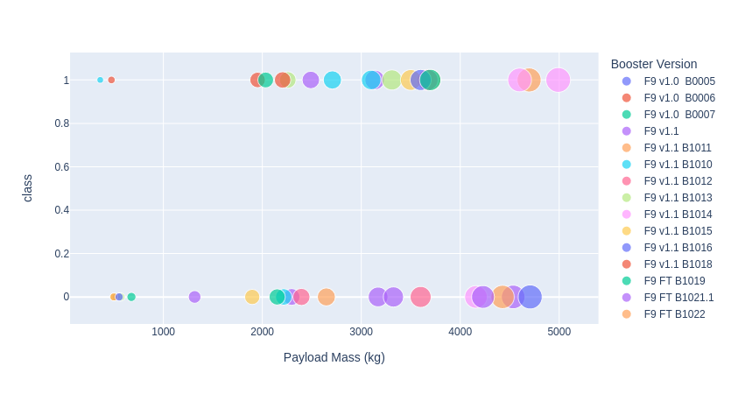
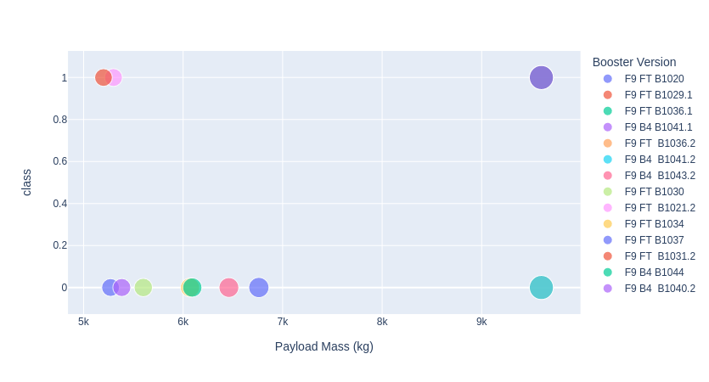
Payload vs Launch Outcome scatter plot for all sites
Payload vs Launch Outcome
(0 – 5000kg)
Payload vs Launch Outcome
(5000kg – 10000kg)

Slide 42

Section 5

Slide 43
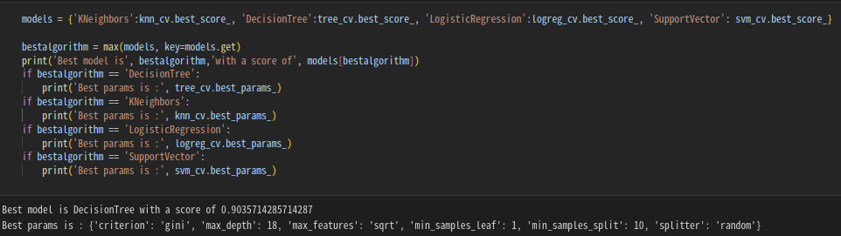
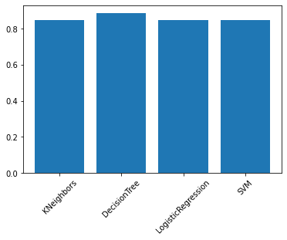
Classification Accuracy

Slide 44
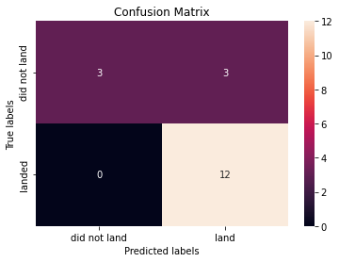
Confusion Matrix
Confusion Matric of prediction with Decision Tree
Can handle most cases
But it has a probability that mark unsuccessful landing as success

Slide 45
Conclusions
Launch success rate increase since 2013
CCAFS SLC-40 is the best launch site
ISS & GTO
For payload mass < 8000
VLEO
For higher payload mass
Decision Tree
Best classification method to predict successful launch and landing

Slide 46


